Slide 1
Module 6: Azure Machine Learning Pipelines

Slide 2
Data Science Building Blocks Project
Prepare data, train models
Hyperparameter tuning
Experimentation and pipelines
Deployment
Monitor and Retrain
Classical ML
Deep learning
Data
Data stores
Data sets
Managed Compute
Azure Machine Learning compute cluster

Slide 3
Data Science Building Blocks Project
Prepare data, train models
Hyperparameter tuning
Experimentation and pipelines
Deployment
Monitor and Retrain
Classical ML
Deep learning
Data
Data stores
Data sets
Managed Compute
Azure Machine Learning compute cluster

Slide 4
Data Science Building Blocks Project
Prepare data, train models
Hyperparameter tuning
Experimentation and pipelines
Deployment
Monitor and Retrain
Classical ML
Deep learning
Data
Data stores
Data sets
Managed Compute
Azure Machine Learning compute cluster

Slide 5
Data Science Building Blocks Project
Prepare data, train models
Hyperparameter tuning
Experimentation and pipelines
Deployment
Monitor and Retrain
Classical ML
Deep learning
Data
Data stores
Data sets
Managed Compute
Azure Machine Learning compute cluster

Slide 6
Azure Machine Learning pipelines
Prepare data
Build & train models
Deploy & predict
Data Preparation
Model building & training
Model deployment
Data ingestion
Normalization
Hyper-parameter tuning
Deployment
Transformation
Automatic model selection
Batch scoring
Validation
Model testing
Data storage locations
Featurization
Model validation

Slide 7
Advantages of Azure ML Pipelines
Unattended runs
Schedule a few steps to run in parallel or in sequence to focus on other tasks while your pipeline runs
Tracking and versioning
Name and version your data sources, inputs and outputs with the pipelines SDK
Reusability
Create templates of pipelines for specific scenarios such as retraining and batch scoring
Mixed and diverse compute
Use multiple pipelines that are reliably coordinated across heterogeneous and scalable computes and storages

Slide 8
Model management
Create/Retrain Model
Enable DevOps with full CI/CD integration with VSTS
Register Model
Track model versions with a central model registry
Monitor
Oversea deployments through Azure AppInsights

Slide 9
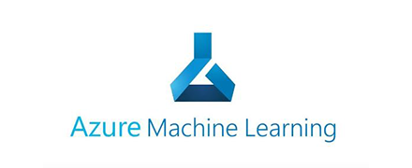
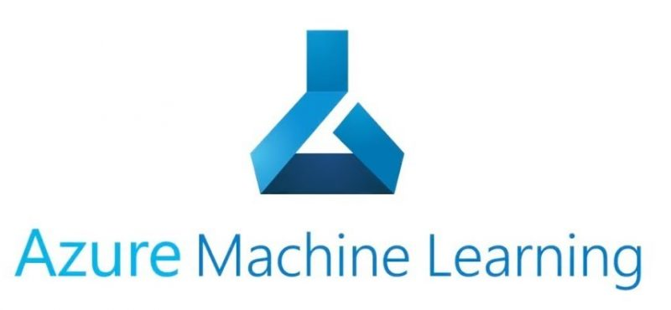
train.py
Conda_dependencies.yml
Azure Managed Compute
Subset data
Training script
Data sets
Environment
Compute
train_sumit.py
Hyperdrive Run configuration
Search grid
logs
Experiment
Submit run
Parent run
Child runs

